Slide 1
Design and Analysis of Algorithms
Algorithms-II : CS345A
Lecture 2
Divide and Conquer Paradigm – I
- Closest Pair of Points

Slide 2
Divide and Conquer paradigm

Slide 3
An Overview
Divide the problem instance into two or more instances of the same problem.
Solve each smaller instance recursively (base case suitably defined).
Combine the solutions of the smaller instances
to get the solution of the original instance.
Notes:
How do we solve any problem in this paradigm ?
The 3rd step (Combine step) is usually the main nontrivial step in the design of an algorithm using divide and conquer strategy

Slide 4

Example Problems
Merge Sort
Multiplication of two $n$-bit integers.
Counting the number of inversions in an array.
Finding median of $n$numbers in linear time.

Slide 5
Divide and Conquer Paradigm (Advanced Problems)
Geometric Problems:
Closest Pair Distance
Convex Hull
Non-dominated Points
Number theoretic Problem
Multiplication of 2 Polynomials

Slide 6





Distance between 2 points
$$(x_{j},y_{j})$$
O($1$) time
$$(x_{i},y_{i})$$
$$y$$
$$x$$

Slide 7

The Closest Pair Distance Problem
$$δ$$
$$y$$
$$x$$

Slide 8
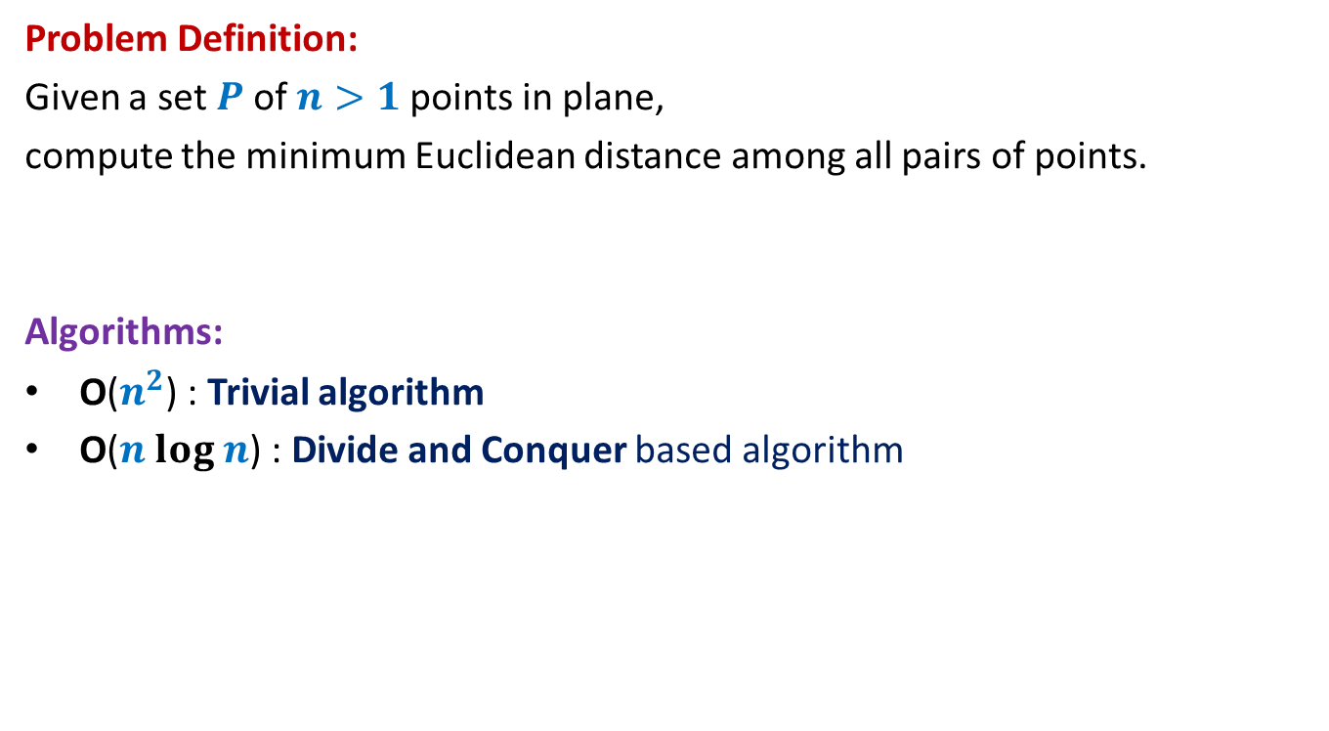
The Closest Pair Distance Problem
Problem Definition:
Given a set $P$of $n>1$points in plane,
compute the minimum Euclidean distance among all pairs of points.
Algorithms:
O($n^{2}$) : Trivial algorithm
O($n log n$) : Divide and Conquer based algorithm
We shall use 3 tools to design this algorithm. Please make sure you internalize them well.

Slide 9

Question 1
Tool 1
A fact from high school geometry
Fact :
Let $p=(x_{1},y_{1})$ and $q=(x_{2},y_{2})$ be any two points.
If $\left|x_{1}−x_{2}\right|>δ$, distance($p,q$) $>δ$
If $\left|y_{1}−y_{2}\right|>δ$, distance($p,q$) $>δ$

Slide 10




A discrete math exercise
Tool 2
Exercise:
What is the maximum number of points that can be placed in a unit square
such that each pair of them is separated by distance at least 1 ?
Answer: 4.
$$δ−$$
$$δ$$
$$\frac{1}{\sqrt{2}}$$
1
$$δ$$
Notes:
If there are more than 4 points in the unit square,
at least one of the four small squares will have more than 1 points.

Slide 11
Question 2
Tool 3
A fundamental question about data structure ?
Question:
While solving an algorithmic problem, when do we feel the need of an
efficient data structure ?
Answer:
when the algorithm involves “many” operations of same type on a given data.
Notes:
For example, it is worth sorting an array only if there are going to be many search queries on it.
Let us see if you can use this principle to solve this problem.

Slide 12
a Divide and Conquer algorithm for
Closest Pair Distance

Slide 13


The divide step
$$y$$
$$x$$

Slide 14



Solving the problem in 1-dimension
Median of $n$ points.
$$y$$
$$x$$
Left half set
$⌈\frac{n}{2}⌉$points
$⌊\frac{n}{2}⌋$points
Right half set

Slide 15




Solving the problem in 1-dimension
We can not afford to compute distance between each point of the left half set and each point of the right half set.
We need to consider only one point from the left half set
and one point from the right half set. Can you spot them ?
T($n$) = c $n$ + 2 T($n$/2)
$=O$($n\log{n}$)
$$δ_{L}$$
$$δ_{R}$$
$$x$$
Left half set
$⌈\frac{n}{2}⌉$points
$⌊\frac{n}{2}⌋$points
Right half set

Slide 16
How to extend to 2-dimensions
$$x$$

Slide 17
The divide step
$$y$$
$$x$$

Slide 18



Solving the 2 smaller instances
$$δ_{L}$$
$$δ_{R}$$
Left half set
$⌈\frac{n}{2}⌉$points
$δ$ ← min($δ_{L}{,δ}_{R}$)
$⌊\frac{n}{2}⌋$points
Right half set
Notes:
1. Compute the closest pair distance of the left half set
2. Let it be Delta_L.
3.Compute the closest pair distance of the right half set
4. Let it be Delta_R.

Slide 19



The combine step
Tool 1
$$>δ$$
$$δ_{L}$$
$$δ_{R}$$
$$δ$$
$$δ$$
$δ$ ← min($δ_{L}{,δ}_{R}$)
Notes:
Which points do we need to focus on for the closest pairs ?
The total number of these pairs are Theta(n^2).
How to do it efficiently ?
Exploit the geometric aspect of the problem.
Time to use Hint 1.
For a point in the left half set, if its distance to any point in the right set is less than delta, can we infer anything about its x-coordinate.
: Its x-coordinate can not be less than the x-coordinate of the other point by more than delta.

Slide 20


The combine step
Potentially $Θ(n)$ points in each strip
$$δ_{L}$$
$$δ_{R}$$
$$δ$$
$$δ$$
$δ$ ← min($δ_{L}{,δ}_{R}$)
Notes:
But there may still be $Θ(n)$ points in each of these strips.
So what to do ?

Slide 21


The combine step
Do we need to compute distance from $p$
to each point of the red strip ?
Tool 1
$$δ_{L}$$
$$p$$
$$δ_{R}$$
$$δ$$
$$δ$$
$δ$ ← min($δ_{L}{,δ}_{R}$)
Notes:
1. Only the points lying in these 2 red squares are relevant as far as $p$ is concerned.
2. Time to use Hint 2
3. Surely not more than 8.
-----------------------------
1. How to find the points in these red square for point $p$?

Slide 22

The combine step
Tool 1
$$δ_{L}$$
$$δ$$
$$p$$
$$δ$$
$$δ_{R}$$
$$δ$$
$$δ$$
$δ$ ← min($δ_{L}{,δ}_{R}$)
Notes:
1. Only the points lying in these 2 red squares are relevant as far as $p$ is concerned.
2. Time to use Hint 2
3. Surely not more than 8.
-----------------------------
1. How to find the points in these red square for point $p$?

Slide 23

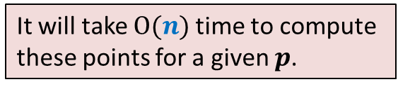
The combine step
But we need to do this task for each point of left strip.
How many points lie in these 2 squares ?
Tool 2
$$δ_{L}$$
It will take $O(n)$time to compute
these points for a given $p$.
$O(1)$points only
$$δ$$
$$p$$
$$δ$$
$$δ_{R}$$
$$δ$$
$$δ$$
$δ$ ← min($δ_{L}{,δ}_{R}$)
Notes:
1. Only the points lying in these 2 red squares are relevant as far as $p$ is concerned.
2. Time to use Hint 2
3. Surely not more than 8.
-----------------------------
1. How to find the points in these red square for point $p$?

Slide 24
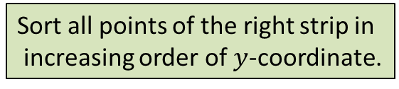






The combine step
But we need to do this task for each point of left strip.
Tool 3
$$δ$$
$$δ$$
$$δ$$
$$δ$$
Sort all points of the right strip in
increasing order of $y$-coordinate.
$$δ_{L}$$
$$δ$$
$$δ$$
$$δ$$
$$(x^{′},y^{′})$$
Binary search for ($y^{′}+δ$)
$$p$$
$$δ$$
Binary search for ($y^{′}−δ$)
$$δ_{R}$$
$$δ$$
$$δ$$
$δ$ ← min($δ_{L}{,δ}_{R}$)

Slide 25


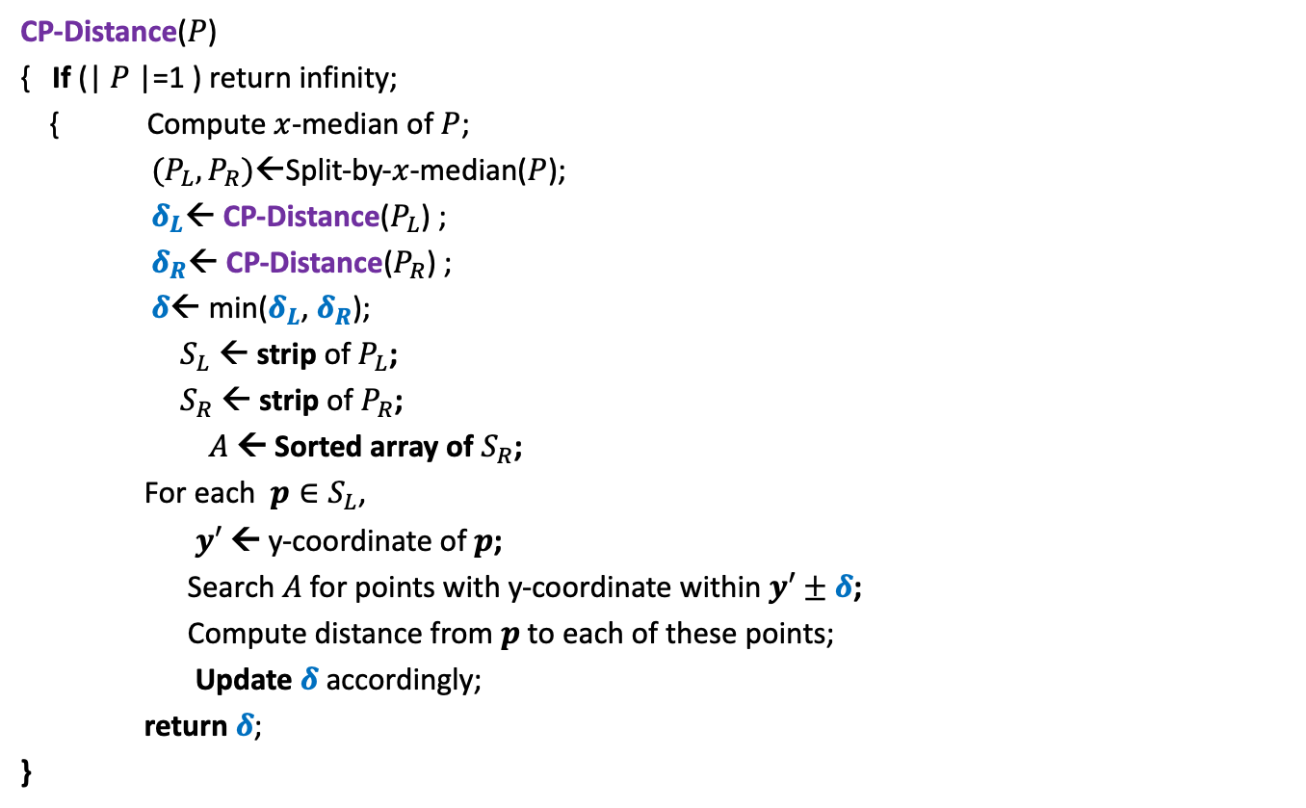
Divide and Conquer based algorithm
CP-Distance($P$)
{ If (| $P$|=1 ) return infinity;
{ Compute $x$-median of $P$;
$(P_{L},P_{R})$←Split-by-$x$-median($P$);
$δ_{L}$← CP-Distance($P_{L}$) ;
$δ_{R}$← CP-Distance($P_{R}$) ;
$δ$← min($δ_{L}$, $δ_{R}$);
$S_{L}$ ← strip of $P_{L}$;
$S_{R}$ ← strip of $P_{R}$;
$A$← Sorted array of $S_{R}$;
For each $p∈S_{L}$,
$y′$ ← y-coordinate of $p$;
Search $A$for points with y-coordinate within $y′±δ$;
Compute distance from $p$to each of these points;
Update $δ$ accordingly;
return $δ$;
}
$O(\left|P\right|)$ + 2 T(|$P$|/2) time
Divide step
$O(\left|P\right| \log{|P|})$ time
Combine/conquer step

Slide 26


Running time of the algorithm
What is the recurrence for running time?
T($n$) = c $n$ log $n$ + 2 T($n$/2)
➔
T($n$) = O( $n$ $\log^{2}n$)
Theorem:
There exists an O( $n$ $\log^{2}n$) time algorithm to compute the closest pair distance of $n$points in plane.
c $n$

Slide 27




The conquer step in O($n$) time
If the two strips are already sorted
$$δ_{L}$$
$$δ_{R}$$
$$δ$$
$$δ$$
$δ$ ← min($δ_{L}{,δ}_{R}$)

Slide 28
Inspiration from Merge sort
Merge
Notes:
In merge sort, the two recursive calls return sorted lists.
So creating the sorted list requires only merging them.

Slide 29

Homework 1
Make sincere attempts to execute conquer step in O($n$) time.

Slide 30
problem 2
Non-dominated Points

Slide 31





The Non-Dominated Points
y
Definition: point $p$ is said to dominate point $q$ if
x($p$) > x($q$)
and y($p$) > y($q$)
$$p$$
$$q$$
$$q$$
$$(0,0)$$
x

Slide 32
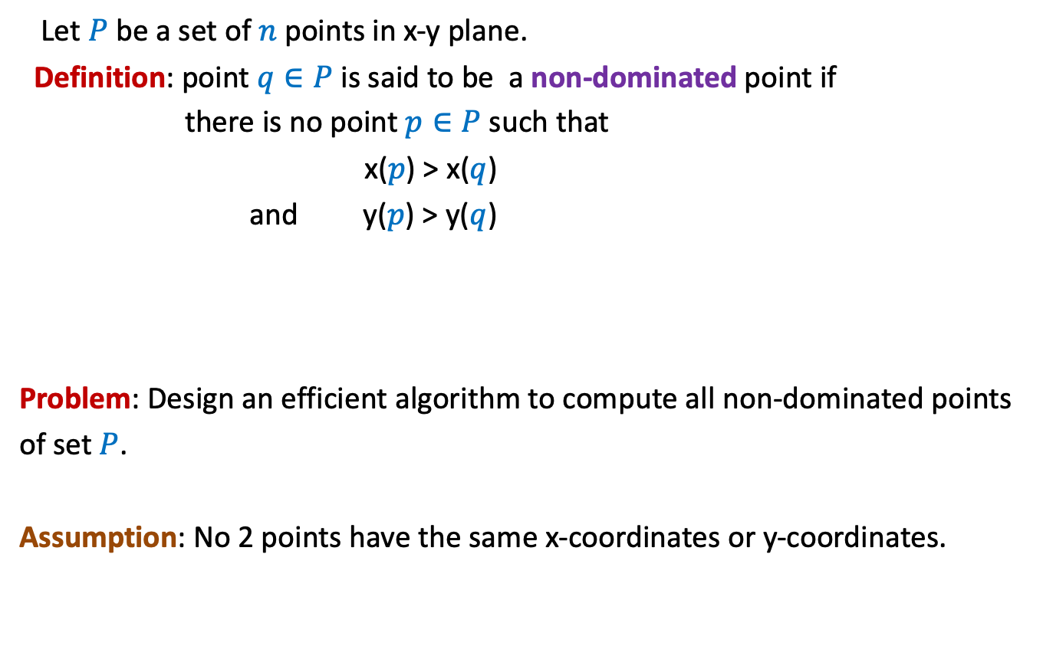
The Non-Dominated Points
Let $P$ be a set of $n$ points in x-y plane.
Definition: point $q∈P$ is said to be a non-dominated point if
there is no point $p∈P$ such that
x($p$) > x($q$)
and y($p$) > y($q$)
Problem: Design an efficient algorithm to compute all non-dominated points
of set $P$.
Assumption: No 2 points have the same x-coordinates or y-coordinates.

Slide 33


The Non-Dominated Points
y
Can you spot all non-dominated points
$$q$$
$$p$$
$$(0,0)$$
x

Slide 34
The Non-Dominated Points
y
What structure emerges ?
$$(0,0)$$
x

Slide 35
The Non-Dominated Points
y
$$p$$
$$(0,0)$$
x

Slide 36
Homework 2
Make sincere attempt to design an efficient algorithm for non-dominated points.

